Slide 1
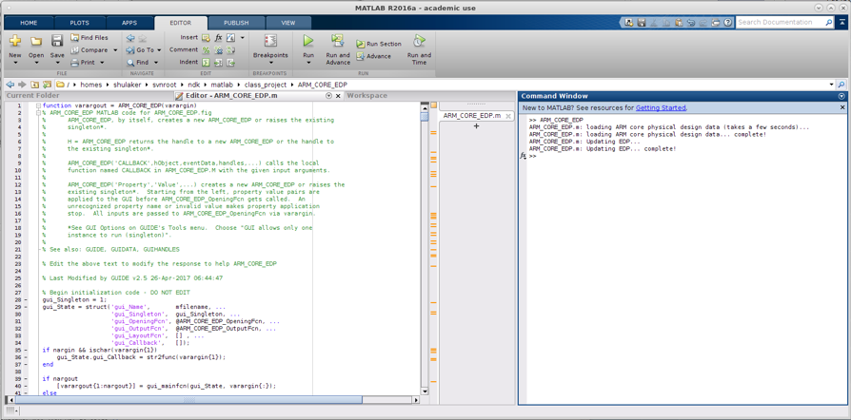
to run ARM_CORE_EDP:
extract the ARM_CORE_EDP archive
Open matlab and go to the extracted directory
Run the command: ARM_CORE_EDP
extracted directory
matlab command

Slide 2
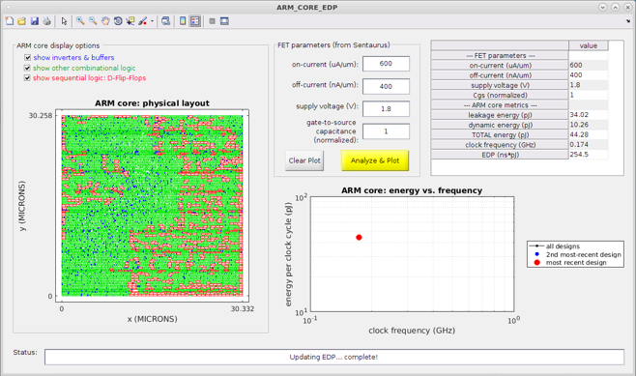
If the code ran successfully, this GUI will pop up

Slide 3
This is the physical design of the ARM chip, including:
- Inverters & buffers to meet timing constraints,
- Combinational logic to implement arithmetic in the core,
- And sequential logic to keep state for executing programs

Slide 4
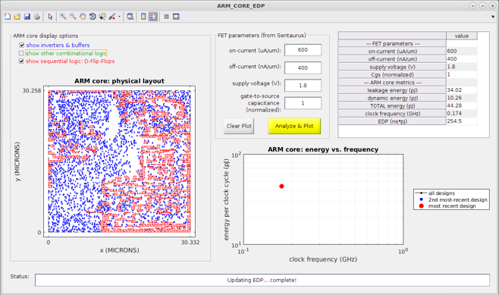
This is the physical design of the ARM chip, including:
- Inverters & buffers to meet timing constraints,
- Combinational logic to implement arithmetic in the core,
- And sequential logic to keep state for executing programs
You can toggle what is displayed. This is only for visualization (you don’t
need to do anything with this window)

Slide 5
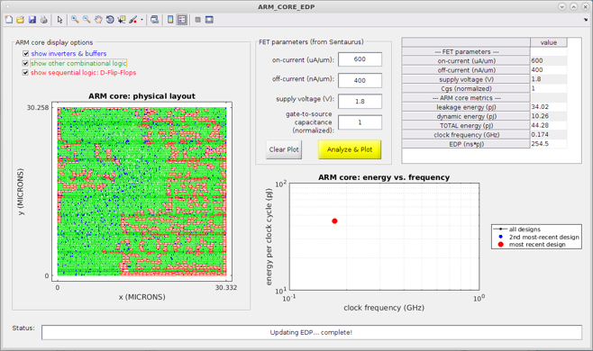
This is the main energy & delay for the ARM core

Slide 6
Update the FET values with your values from Sentaurus

Slide 7
The ARM core energy & frequency will be shown here

Slide 8

For example, one way to increase clock frequency is by increasing VDD to increase on-current; here, VDD is increased to 2.2 V, and on-current is increased to 900 uA/um

Slide 9
Then click “Analyze & Plot”

Slide 10
And the new point is updated
Your most recent design
Is always shown in red

Slide 11

Continuing to increase VDD & on-current
Increases both clock frequency & energy,
Which gives a trade-off for EDP

Slide 12

And again… notice the EDP is getting worse (higher)

Slide 13
In this case, the best EDP is in the middle of the curve

Slide 14
You can also click “Clear Plot”
to remove all existing data from the plot

Slide 15

Another strategy is the increase the threshold voltage, which lowers off-current at the cost of lower on-current

Slide 16
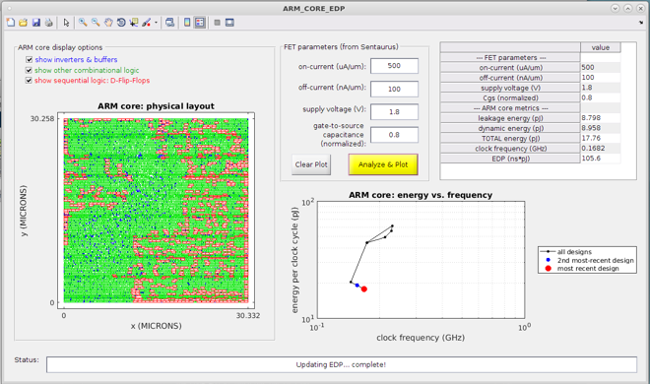
As you will see, these parameters can be inherently difficult to trade-off! But remember – the specifications you want might not be the specifications you can achieve with your transistor! (extracted from Sentaurus)

